Slide 1
NSCap
@CS.NCTU
Final Project
Wi-fi Rate Control on Ryu and OVS
Instructor: Kate Lin

Slide 2
Objectives
In the final project, we are going to do the rate control by using Ryu controller based on Wi-fi signals of different devices You’ll learn:
How to get the Wi-fi signals of different devices and
make Ryu get this information
b. How to add flow rules based on SNR and use
iperf to test the total receiving bandwidth

Slide 3
Goal
After that, you should reach the goal that
The total receiving bandwidth of a device should be propotional to its Wi-Fi SNR
=> On the upwarding part, using iperf, with 10 UDP
flows listening on different ports
2. The difference(error) between ratio of bandwith and SNR ratio should be at most 1, while trying to maximize the total throughput.

Slide 4
Overview

Slide 5




Overview
Send signal information
Add appropriate flow rules
Connect (Wi-Fi)

Slide 6
Tasks

Slide 7
Task 1. Handling Wi-Fi information
Connect Wan port to the Internet, and controller port to one device
Connect 2 devices (better to be computer) to the router Wi-Fi
# ssh 192.168.2.1
Get Wi-Fi information
# iw dev [interface] station dump | grep -i signal // get the Wi-Fi signal
Other available information (e.g. Hardware MAC, DHCP IP address)
is in “/proc/net/arp” “/var/dhcp.leases”

Slide 8
Task 1. Handling Wi-Fi information
Send the Wi-Fi signals of 2 devices plus any information(previous page) you may need in your controller
Pack these data in the packet of openflow protocol, and using “nc” command to send to the controller port
You need to run your Ryu-manager first
Follow the openflow spec format to make openflow packets
P101 of https://opennetworking.org/wp-content/uploads/2013/04/openflow-spec-v1.3.1.pdf

Slide 9
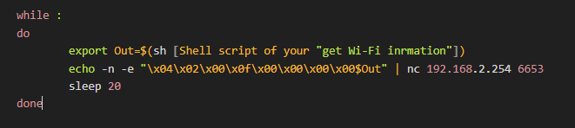
Task 1. Handling Wi-Fi information
For example, You can use packet of type “OFPT_ECHO_REQUEST”
“Sleep 20” to let controller monitor the signal periodically
You can use another packet type also, as long as this kind of data has additional data field (e.g. OFPT_EXPERIMENTER)
Packet type

Slide 10
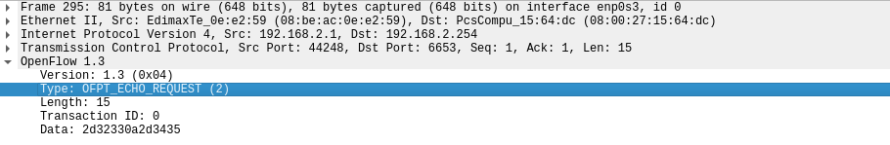
Task 1. Handling Wi-Fi information
After sending, you would see the packet like the figure below using Wireshark.
If successful, then your Ryu controller can add flow rules based on these information.

Slide 11
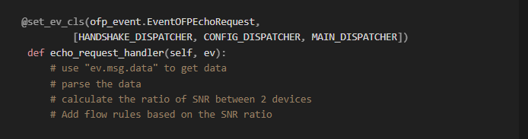
Task 2. Parse information on Ryu
Set a new event and define a new event handler, based on what type of packet you send in task1
For example, if you use the packet type of “OFPT_ECHO_REQUEST”,
then you can set like below

Slide 12
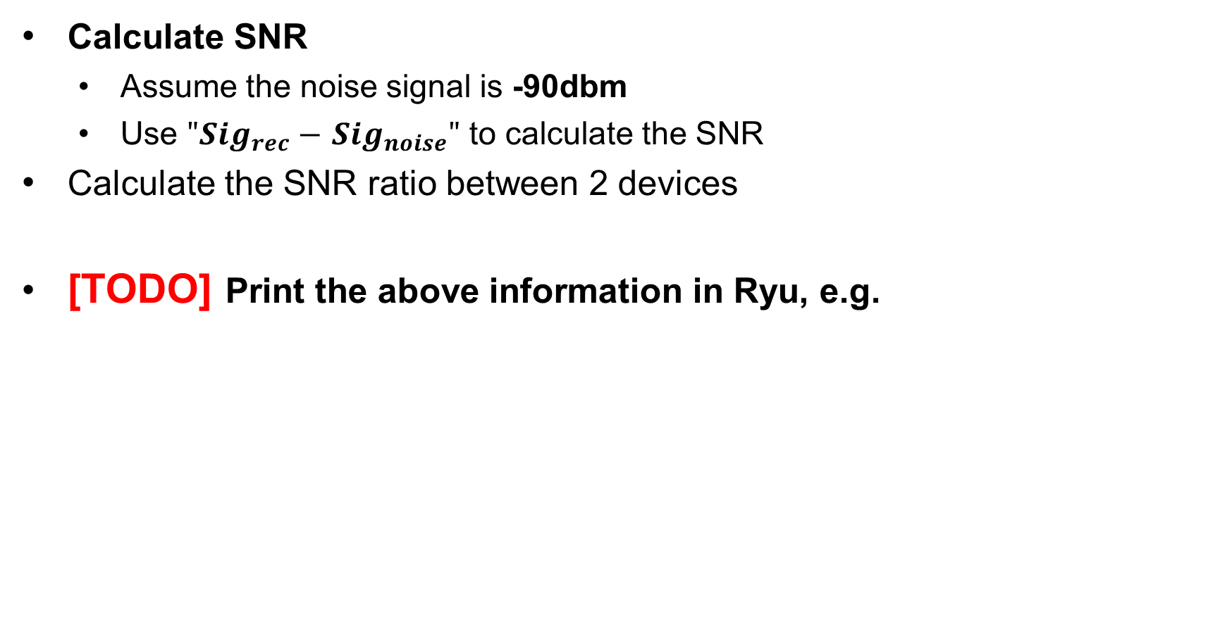
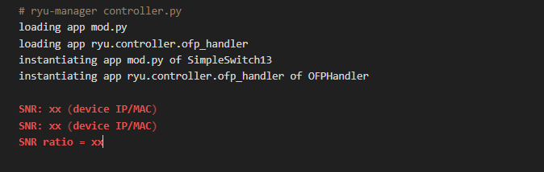
Task 2. Parse information on Ryu

Slide 13
Task 2. Parse information on Ryu
Notice
You should set your event at least in the “HANDSHAKE_DISPATCHER”,
or the packet event would not be triggered

Slide 14
Task 3. Adding flow rules on Ryu
Use “iperf / iperf3” command to measure the bandwidth in your network with your Ryu controller
Destined to 192.168.2.254
Listening on 10 ports => 2501-2510
Use UDP flows
Run iperf server on 192.168.2.254
Run iperf client on another 2 devices

Slide 15
Task 3. Adding flow rules on Ryu
• iperf Command line option
• -s: (Server) Run iperf in server mode
• -c: (Client) Run iperf in client mode, connecting to an iperf server running on host
• -i: (Interval) Sets the interval time in seconds between periodic bandwidth, jitter, and loss reports
• -t: (Time) The time in seconds to transmit for
• -p: (Port) The server port for the server to listen on and the client to connect to
• -u: (UDP) Use UDP flows
• -b: (bandwidth) Set target bandwidth to n bits/sec (default 1 Mbit/sec for UDP, unlimited for TCP)
• other

Slide 16
Task 3. Adding flow rules on Ryu
Add “drop rules” on Ryu so that “the SNR ratio” calculated in task2 should as close as to “the ratio of numbers of port forwarded”
E.g. If SNR ratio = 4:1, then you can add 2 drop rules to random 2 ports of device 1, and add 8 drop rules to random 8 ports of device 2
Hints --- The match field should contain these four conditions
eth_type=0x0800
ipv4_src / eth_src = xxx
ip_proto=17
udp_dst=2501

Slide 17

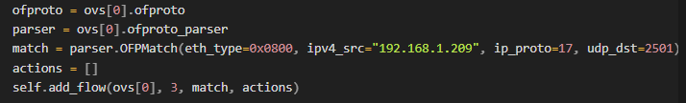
Task 3. Adding flow rules on Ryu
Trouble shooting
After adding the rules, you may not see these rules on OVS
After the modification, you should see your flow rules after running
# ovs-ofctl dump-flows br-lan_ovs

Slide 18

Task 3. Adding flow rules on Ryu
[TODO] Take screenshot after running the command
# ovs-ofctl dump-flows br-lan_ovs
Store the output of iperf server to 10 different text files each device
Calculate the total throughput each device (should be as maximal as possible)
The ratio of throughput between 2 devices should be very close to the SNR ratio (The difference between 2 ratio should be at most 1)

Slide 19
Task4. Report
Your studentID.pdf Should Contain
Screenshots
The shell commands used in task1
Event handler code
2 [TODO] parts mentioned previously
Please also explain them in detail
Discussion
What information do you transport to the controller?
What’s the total throughput of each device respectively?
Is the ratio close to the SNR ratio? Why or why not?

Slide 20
Task4. Report
Bonus
Problem encountered?
Any advises?
Any better modification/improvement on your project to make
it more efficient or convenient?

Slide 21
Submission
Python code --- studentID_controller.py (30%)
Report --- studentID.pdf
Deadline – JUN. 19, 2022. 23:59
Please zip the 2 files and submit to new e3

Slide 22
Grading Policy
Grade
Python program and result correctness – 30%
Report – 70%
Bonus – 20%
Late Policy
(Your score ) * 0.8^{D}, where D is the number of days over due
Cheating Policy
Academic integrity: Homework must be your own – cheaters share the score
Both the cheaters and the students who aided the cheater equally share the score

